Slide 1



Intermediate
Programming
WEEK 2 – Review of Java Basics

Slide 2
Outline
Variables and Data Types
Basic I/O
Basic operators
Selection
Iteration
Arrays

Slide 3

Variable
A way to store data
A program can be viewed as a sequence of instructions
Read a value representing the radius of a circle from the standard input source/stream
Compute the area of a circle with this radius
Print the area to the standard output stream (i.e., the console window)

Slide 4
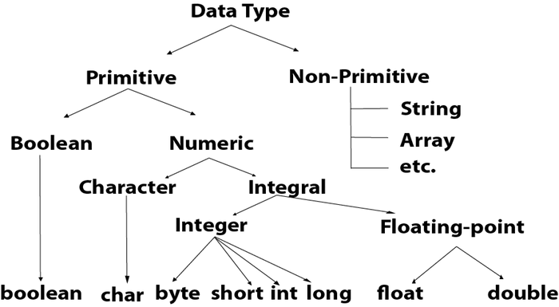
Data Types

Slide 5
Basic Operators
Assignment operators
Arithmetic operators
Relational operators
Logical operators

Slide 6
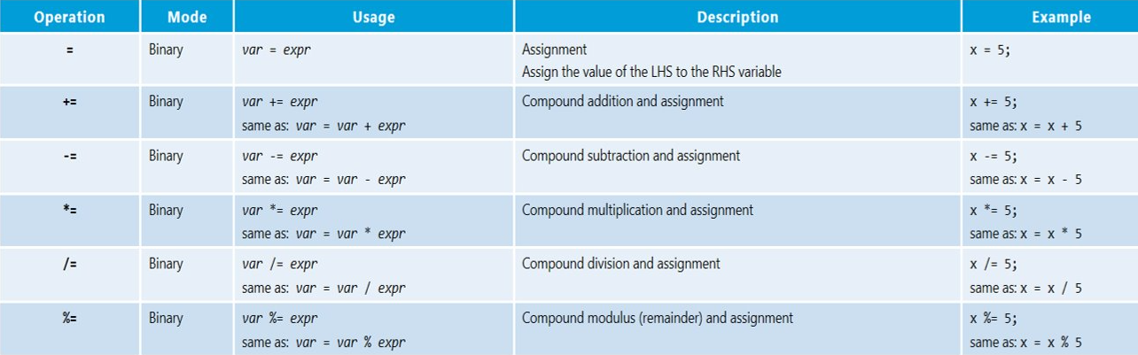
Assignment Operator (=)

Slide 7
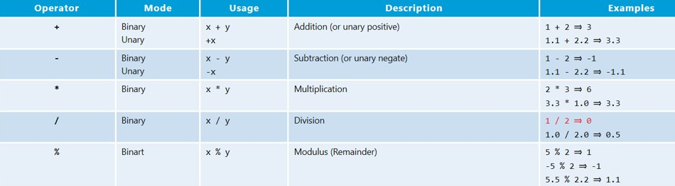
Arithmetic Operators

Slide 8
Level of Precedence
Parenthesis ( )
Unary operators (negate, positive)
Multiplicative ( * , / , % )
Additive ( + , - )
If the operators in the expression are of the same level, they are evaluated from left to right.

Slide 9
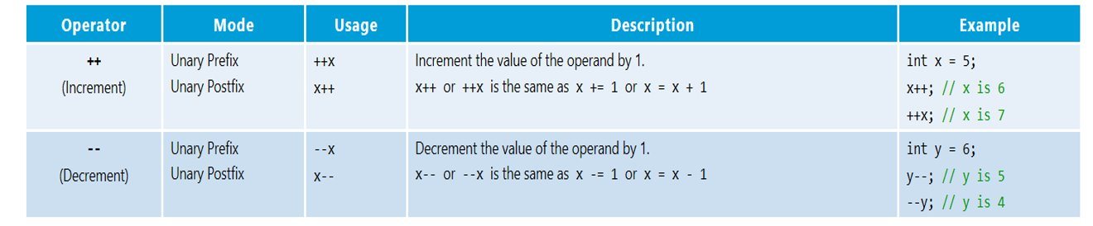
Increment/Decrement

Slide 10
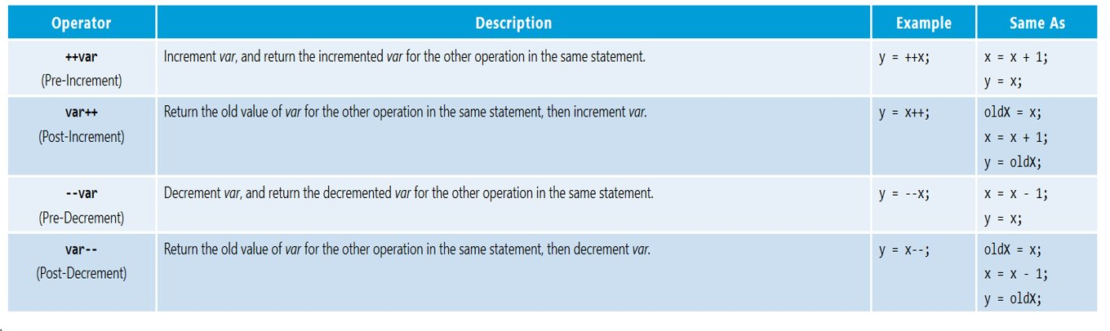
Increment/Decrement

Slide 11
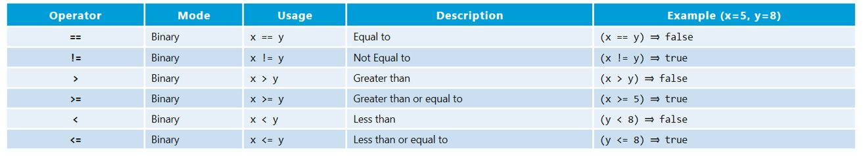
Relational Operators

Slide 12
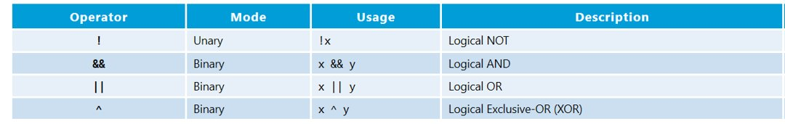
Logical Operators

Slide 13
Selection
If statement
If-else statement
Nested if-else
Switch-case

Slide 14
SCENARIO

Slide 15


Scenario:
You are curious about the story of Wednesday because you are seeing a lot of videos and ads in your social media pages about it. However, you don’t have a Netflix subscription and you don’t want to ask your friends/family what’s their Netflix password. So, you decided to save money from your daily “baon” and track your expenses. To do this, you want to:
Write a Java program that lets you input your daily “baon”
Let’s you select how you spend your “baon” (transpo and food)
When spending, you have multiple options on where to spend it specifically.
Compute your daily savings

Slide 16
Suppose you are only looking at one single day of your expenses and savings.
Write an algorithm to create the desired program.
1. READ baon (input)
2. SELECT spending options
3. COMPUTE savings
4. PRINT savings

Slide 17
Here are your specific expenses (options):
Transportation:
Transportation mode | Going to school | Going home
Jeep | 36 | 36
LRT | 45 | 45
Angkas | 120 | 120
Grab | 340 | 340

Slide 18
Here are your specific expenses (options):
Food
Food | Breakfast | Lunch | Merienda
7eleven | 100 | 150 | 60
Canteen | 45 | 90 | 40
Eatery | 40 | 60 | 40
Alfamart | 75 | 85 | 50
McDonalds | 115 | 185 | 75
Jollibee | 125 | 165 | 75

Slide 19
Iteration
While loop
Do-while loop
For loop

Slide 20
Now you want to compute your daily expenses and savings for 5 days.

Slide 21
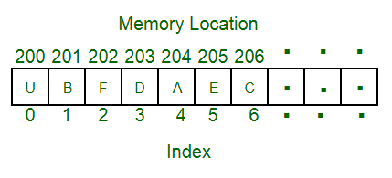
Arrays
An array is a container object that holds a fixed number of values of a single type. The length of an array is established when the array is created. After creation, its length is fixed.
Each item in an array is called an element, and each element is accessed by its numerical index.

Slide 22
You then want to save your savings for each day and identify the day with the most savings

Slide 23
Intermediate
Programming
WEEK 2 – Review of Java Basics

